Slide 1
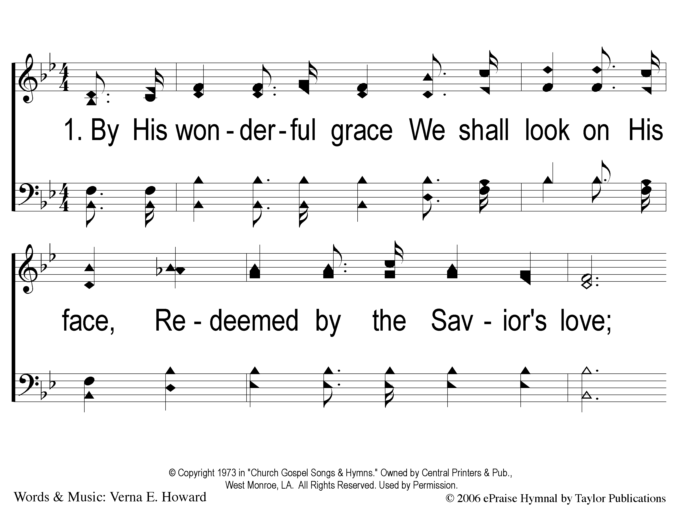
1-1 By His Wonderful Grace
By His Wonderful Grace
41

Slide 2
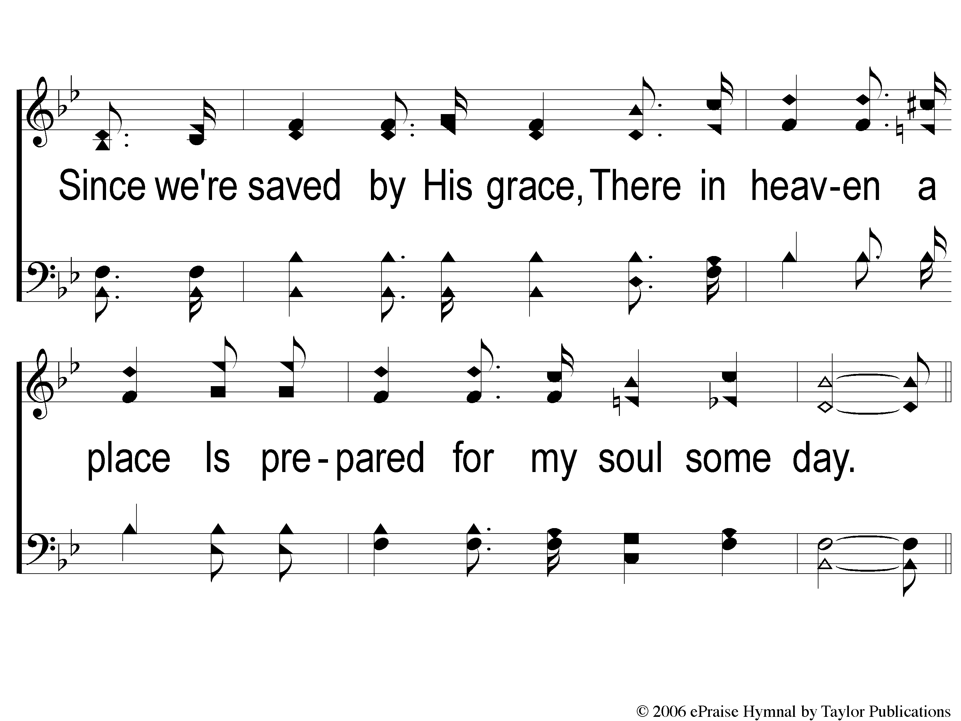
1-2 By His Wonderful Grace
By His Wonderful Grace
41

Slide 3
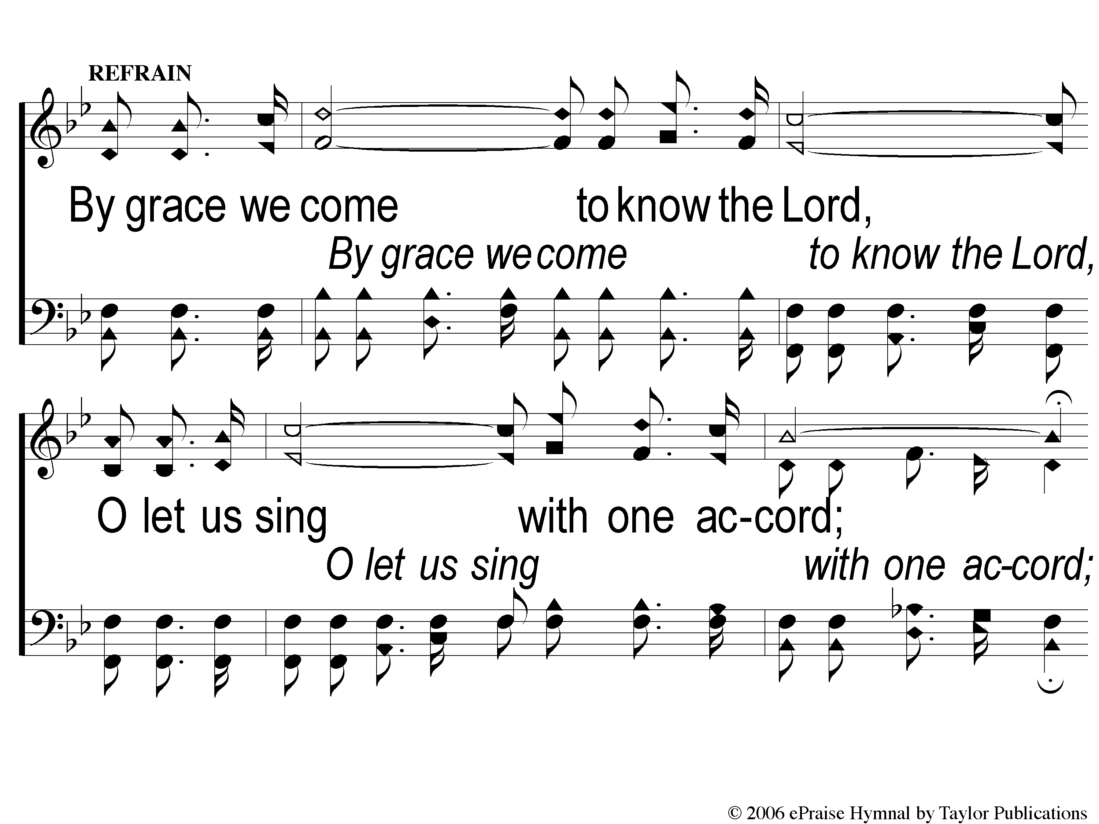
C-1 By His Wonderful Grace
By His Wonderful Grace
41

Slide 4
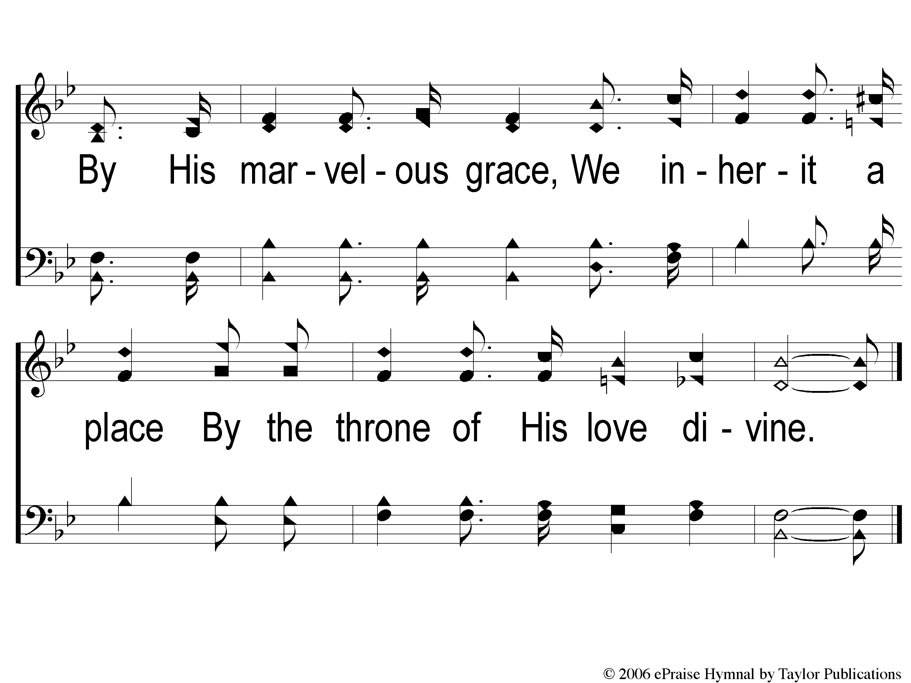
C-2 By His Wonderful Grace
By His Wonderful Grace
41

Slide 5
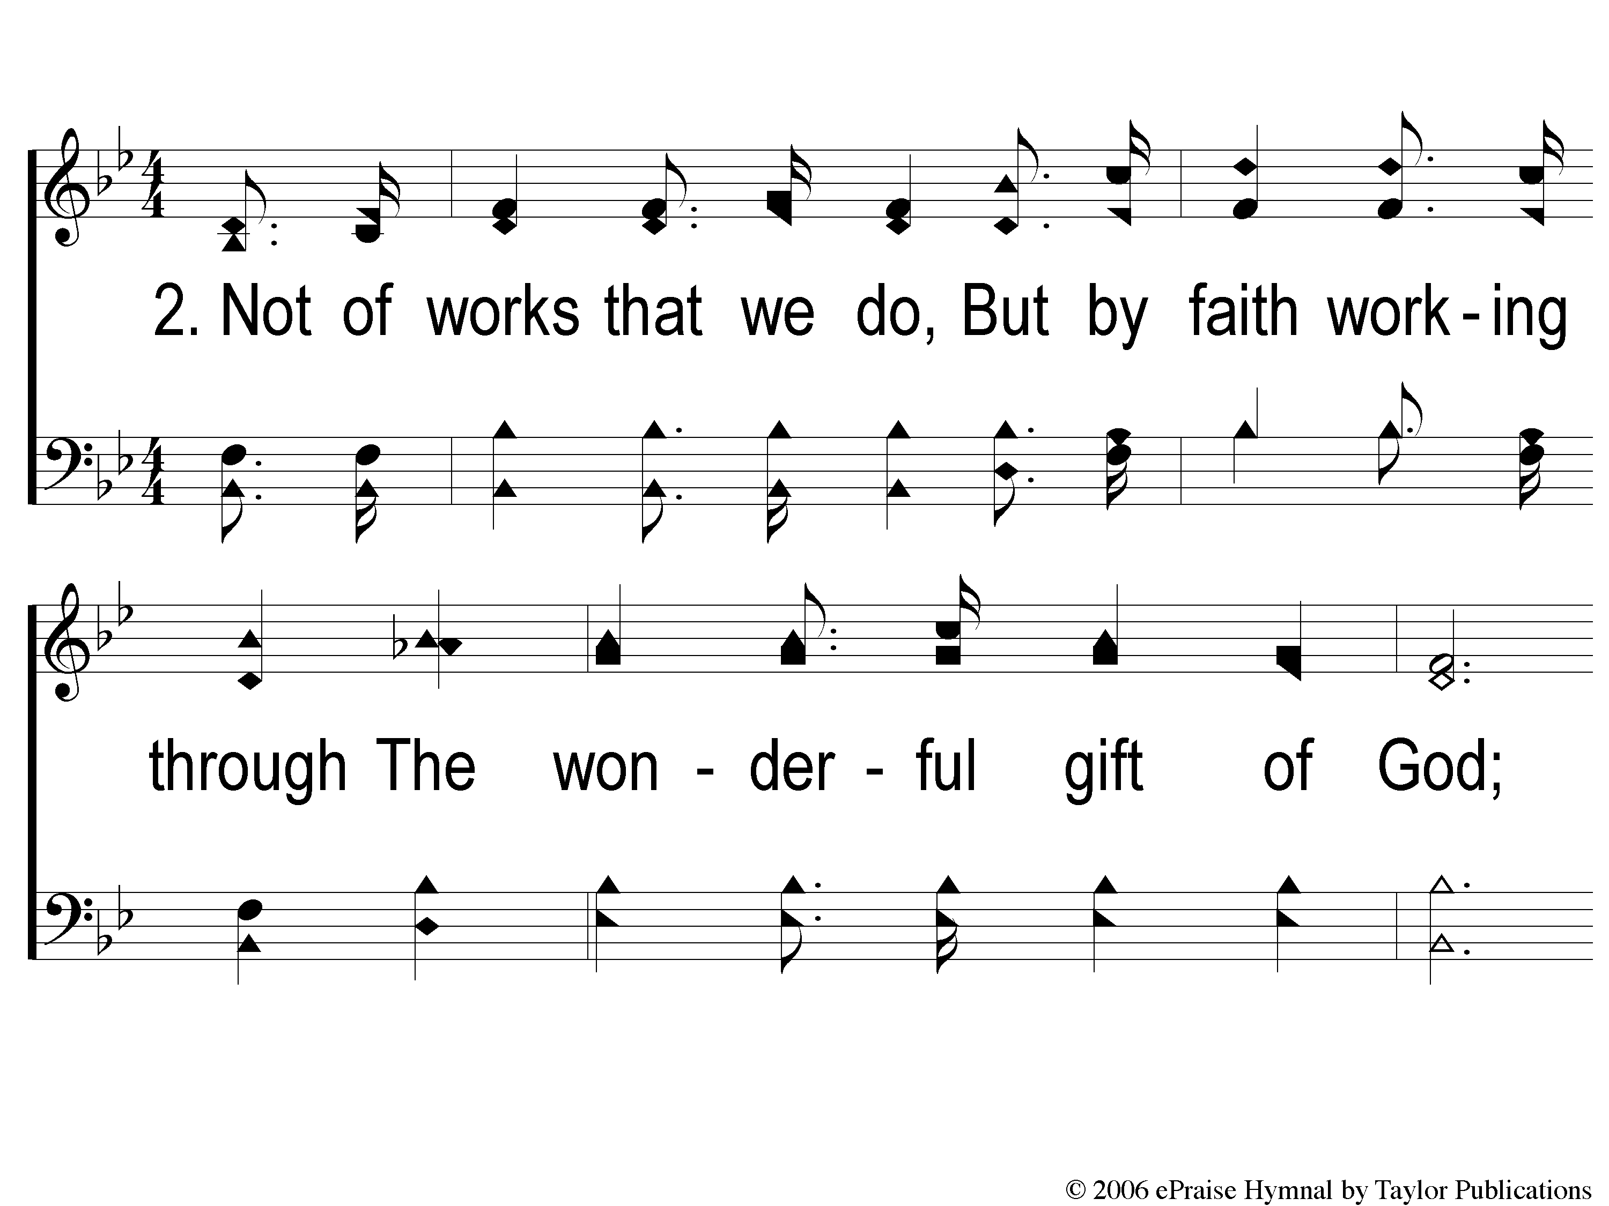
2-1 By His Wonderful Grace
By His Wonderful Grace
41

Slide 6
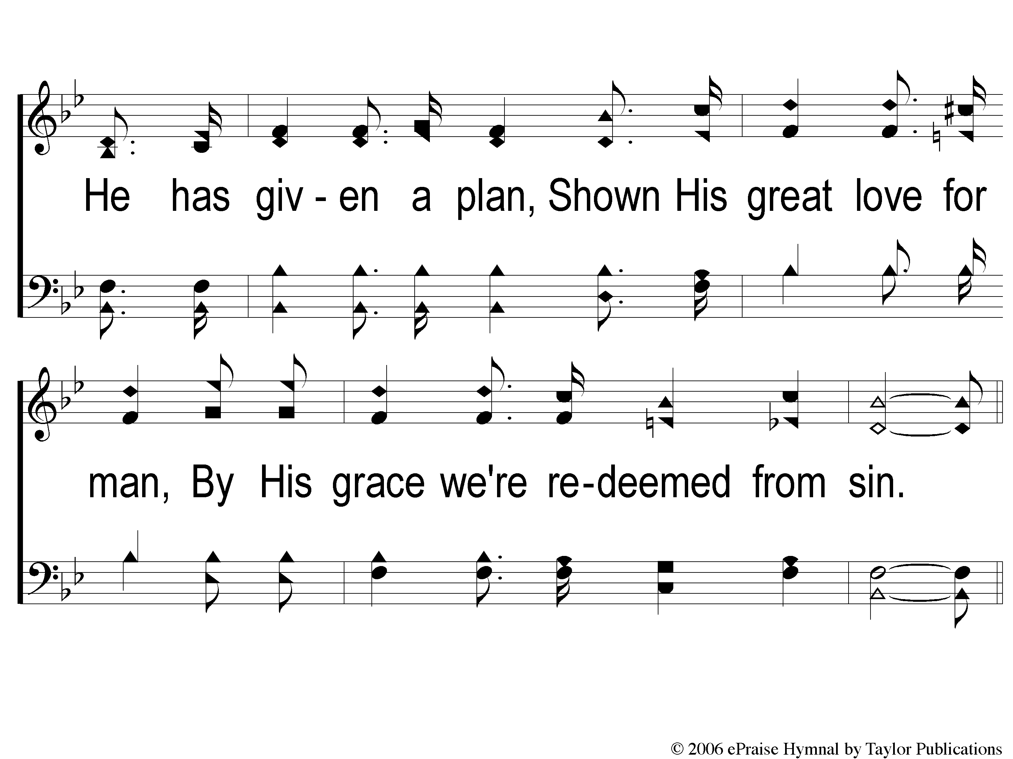
2-2 By His Wonderful Grace
By His Wonderful Grace
41

Slide 7
C-1 By His Wonderful Grace
By His Wonderful Grace
41

Slide 8
C-2 By His Wonderful Grace
By His Wonderful Grace
41

Slide 9
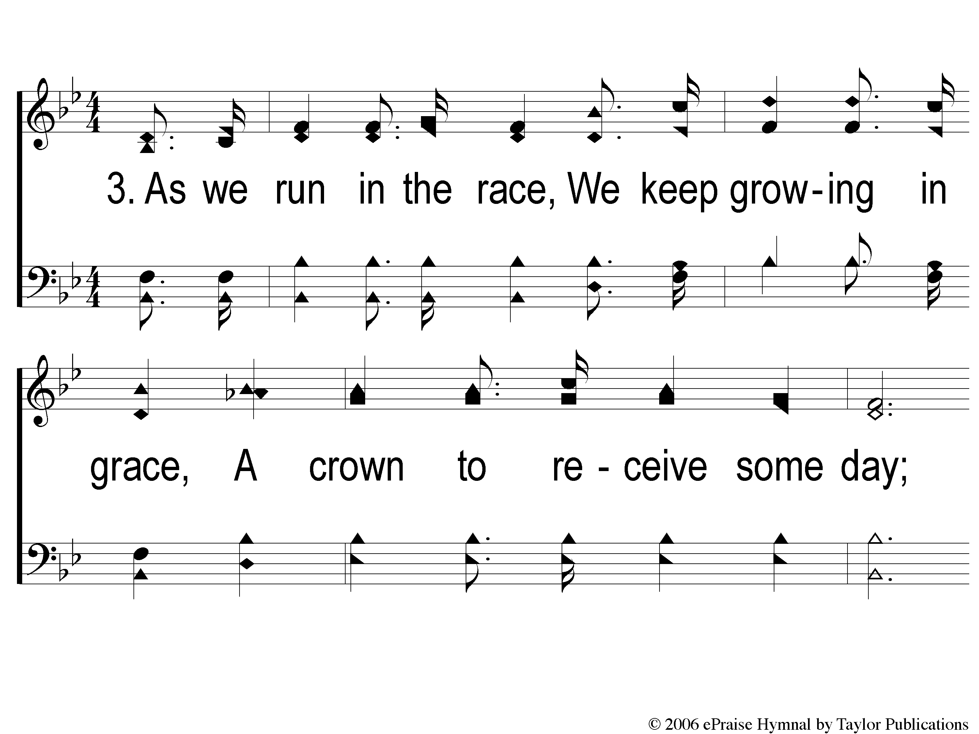
3-1 By His Wonderful Grace
By His Wonderful Grace
41

Slide 10
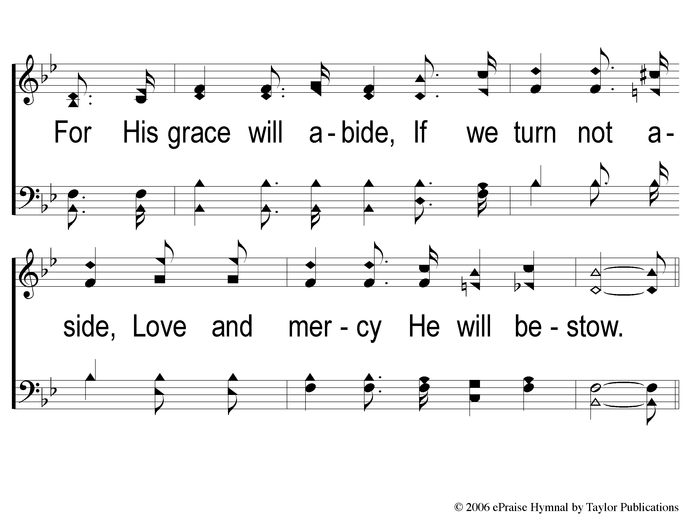
3-2 By His Wonderful Grace
By His Wonderful Grace
41

Slide 11
C-1 By His Wonderful Grace
By His Wonderful Grace
41

Slide 12
C-2 By His Wonderful Grace
By His Wonderful Grace
41

